Slide 1
HR Hour
Performance Review Best Practices

Slide 2

Today's Presenter
Nicole Clark
Senior Implementation Consultant

Slide 3
Evaluation Rollout Preparation
Employee Data Review
System Demonstration
  Updating Evaluation Forms
  Goals Review
  Scheduling/Assigning Evaluations
Performance System Utilization
What's next?

Slide 4
Employee Data Review
CoreHR Data Pass
Verify data in Core is correct, especially Job Codes and Performance Manager
Should be receiving email with errors. If not: contact support or myself
Manual Updates
Verify data is correct, especially Job Codes and Managers
Request 'Reverse User Import' from support if mass changes need to be made

Slide 5
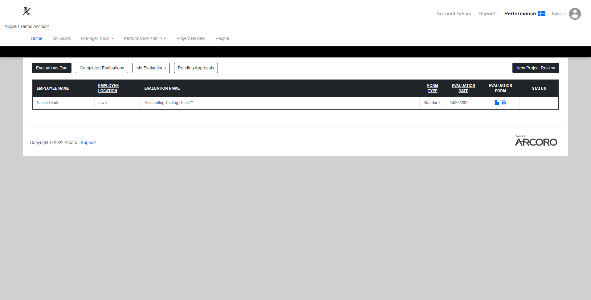
System Demonstration

Slide 6

Q&A

Slide 7
Performance System Utilization
360 Evaluations
Eval created similar to annual eval
Assigned by an admin or manager
Completed results
  Rater is not known
  Summary feedback report
Project Reviews
Eval created similar to annual eval
Ad Hoc – NO ASSIGNMENTS (initiated by rater)
Completed eval seen only by manager

Slide 8
Where to go from here?
Create/Finalize Evaluation form to be used.
Verify employee data is current
Test the system
Communicate with Managers/Employees as needed
Plan ahead for how employees will login
Turn on notifications (Evaluation Notice/Reminder of Evaluation)
Schedule Evaluations
Need More 1x1 training or assistance? Contact your AM

Slide 9
Nicole Clark
Nicole.clark@arcoro.com

Slide 10
Q&A

